Slide 1

CROP RECOMMENDATION SYSTEM USING ML
Presented by: PrasannaKumar Reddy Chirra

Slide 2

Introduction
Problems & Solutions
Data Collection & Data Preprocessing
Data Visualization
Model Selection
Model Evaluation Metrics
Model Accuracy Comparisons
Conclusion
Agenda

Slide 3
Introduction
In this project, my aim is to assist the agricultural community by developing a smart crop recommendation system. By leveraging machine learning algorithms, I analyze a comprehensive dataset containing soil properties, weather conditions. My goal is to provide farmers with data-driven insights, enabling them to make informed decisions for optimal crop selection and resource management.

Slide 4
Problems & Solution
Climate Conditions: Unpredictable weather patterns and climate change.
Resource Management: Managing crucial resources like water and fertilizers efficiently.
Soil Condition: Enhancing Crop Health and Productivity through Effective Soil Management.
Complexity of Decision-Making: Decisions related to crop selection, given the interplay of multiple variables like temperature, humidity, soil health.
Integration of Artificial Intelligence (AI) and Machine Learning (ML) as cutting-edge tools for predictive analysis in crop selection.
Using AI algorithms can analyze vast datasets, including climate data, soil health information, and historical crop performance.
Provide personalized crop recommendations tailored to specific regions, soil conditions, and climate patterns.
AI can mitigate climate risks that can help farmers to adapt climate variability by suggesting crop varieties and planting times.

Slide 5

Data Collection & Data Preprocessing
Data Collection:
Sourced data from Kaggle, a reputable data platform.
Ensured dataset integrity and relevance to our agricultural project.
Data Preprocessing:
Removed null values to enhance data quality.
Prepared a clean dataset for analysis and modeling.

Slide 6
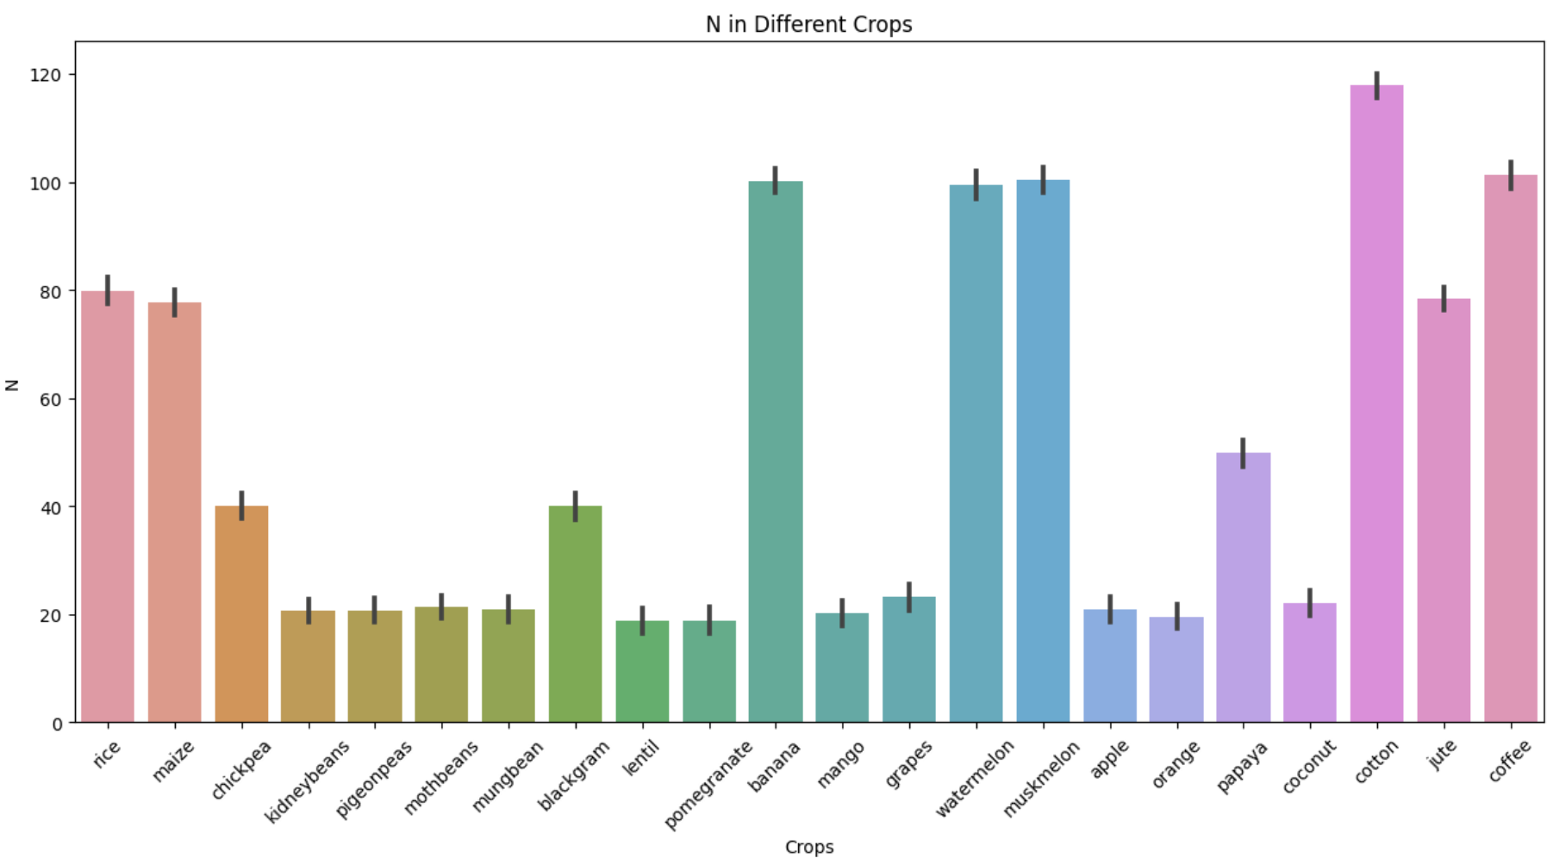
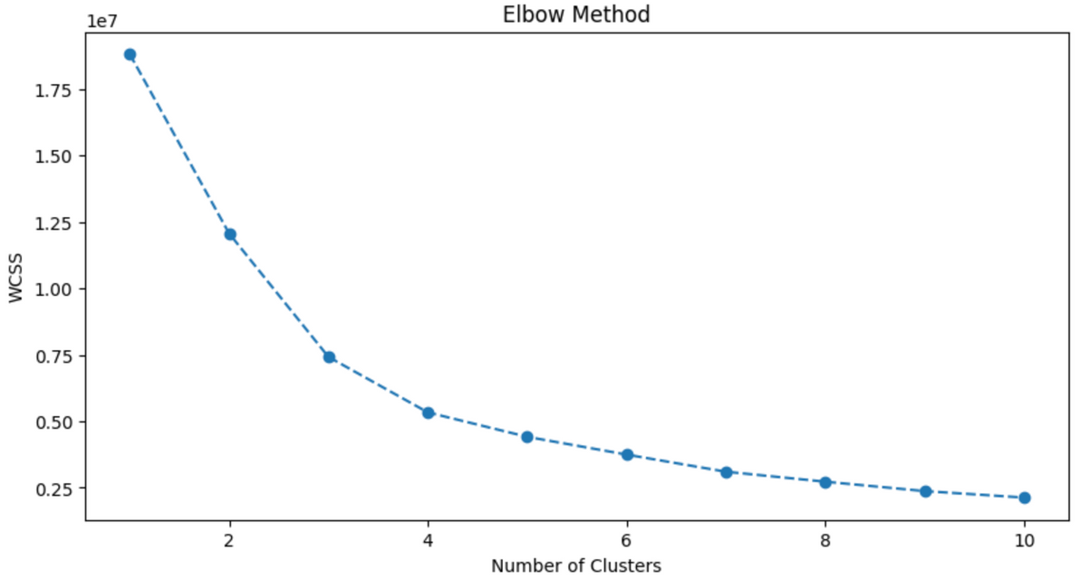
Screenshot 2023-10-03 at 11.32.19 PM
Data Visualization
Display a histogram chart showing the distribution of key soil and weather variables (e.g., N, P, K , temperature, humidity, pH, rainfall).
Cluster Analysis: Cluster analysis is a data exploration technique that groups similar data points together, enabling the identification of patterns, relationships, or distinct categories within a dataset.
Cluster Insights: By employing cluster analysis, we gain valuable insights into the underlying structure of agricultural conditions, allowing us to make informed decisions for crop recommendations and resource allocation.
Applied the Elbow Method to determine the most appropriate number of clusters (k) for our K-Means clustering analysis, which aided in uncovering valuable patterns and insights within the agricultural data.

Slide 7
Screenshot 2023-10-03 at 11.32.19 PM
Model Selection
Logistic Regression: Logistic Regression is a statistical model that estimates the probability of a binary outcome. It's selected for its simplicity and interpretability, making it suitable for predicting crop suitability in our project's binary classification task.
Decision Tree: Decision Tree is a tree-like model used for classification and regression tasks. It's constructed by recursively splitting the dataset into subsets based on the most informative features(Soil & Weather), creating a hierarchy of decisions. It used for making it a valuable choice for crop classification in our project.
Random Forest: Random Forest is a collaborative method that combines multiple Decision Trees. It's chosen for its ability to improve prediction accuracy and reduce overfitting, addressing the challenge of making precise crop recommendations in our dynamic agricultural context.
Support Vector Machines (SVM): SVMs are powerful classifiers used to find hyperplanes that separate data points of different classes. They are selected for their capacity to handle non-linear relationships in soil and weather data, ensuring accurate crop categorization in our project.

Slide 8
Screenshot 2023-10-03 at 11.32.19 PM
Model Evaluation Metrics
Metrics Used:
Accuracy: Measure of overall model correctness.
Precision: Ability to correctly identify relevant crops.
Recall: Ability to capture all relevant crops.
F1-Score: Harmonic mean of precision and recall.

Slide 9
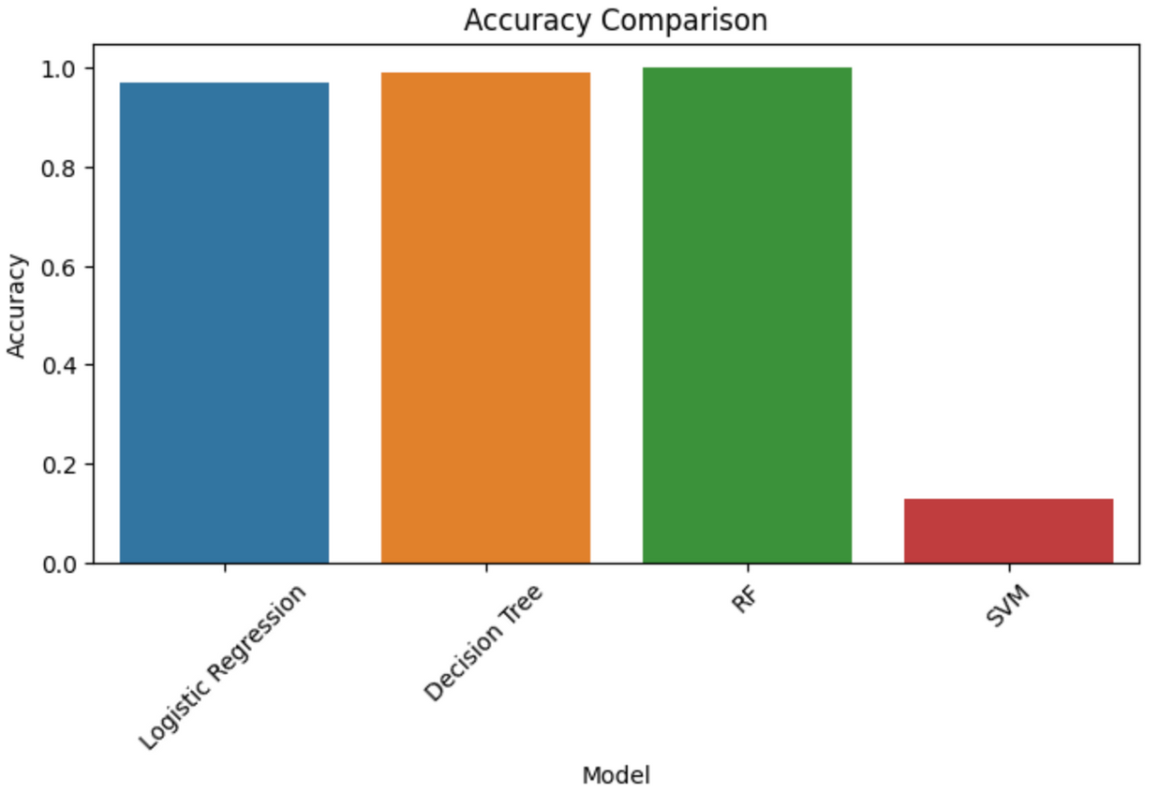
Model Accuracy Comparison
Comparison chart showcasing the accuracy scores of given learning models used in the Crop Recommendation System.
Among the four models, Random Forest consistently showed the best performance with high accuracy, making the preferred choice for crop recommendation in our project.

Slide 10

Conclusion
96.8%
Random Forest achieved the highest accuracy, making it the most suitable model for our crop recommendation system.
Decision Tree also performed well, offering a reliable alternative.
These models provide valuable insights for efficient crop selection.
In closing, the system helps the farmer to choose the right crop by providing insights that ordinary farmers don’t keep track of thereby decreasing the chances of crop failure and increasing productivity.
It also prevents them from incurring losses. The system can be extended to the web and can be accessed by millions of farmers across the country.
Logistic Regression
98.8%
Decision Tree
99.5%
Random Forest
12.7%
svm

Slide 11

Thank You

